Slide 1
Research activities Year 1 – 2nd quarter
April 23, 2020
PhD in Advanced System Engineering
Status update
Student: Veit Gufler
Supervisors: Dr.-Ing. Erich Wehrle
Prof. Renato Vidoni

Slide 2
Previous and planned works
Optimal in-operation redesign of mechanical systems considering vibrations
Multibody dynamics and optimal design
Tyrolean weir cleaning mechanism
Rigid multibody dynamics: 2D => 3D

Slide 3
Multibody dynamics and optimal design of a Tyrolean weir cleaning mechanism

Slide 4
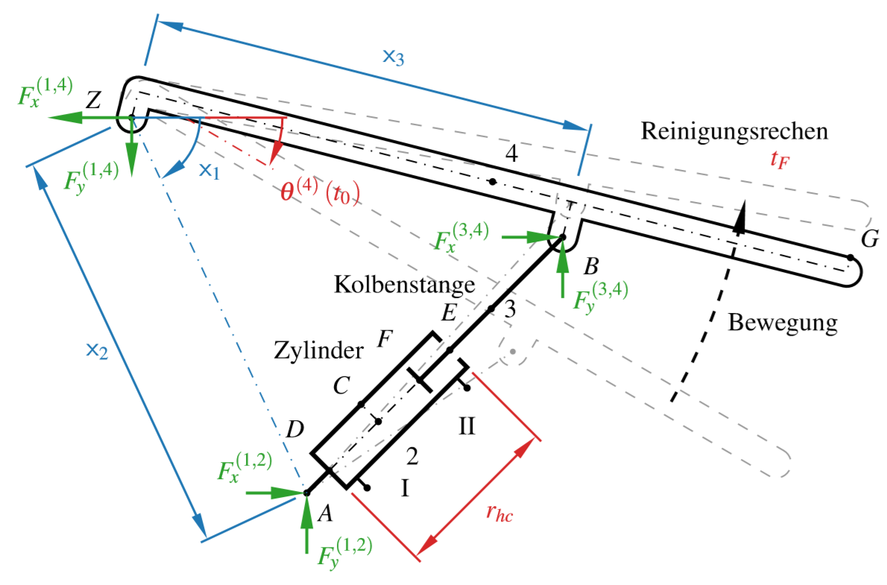
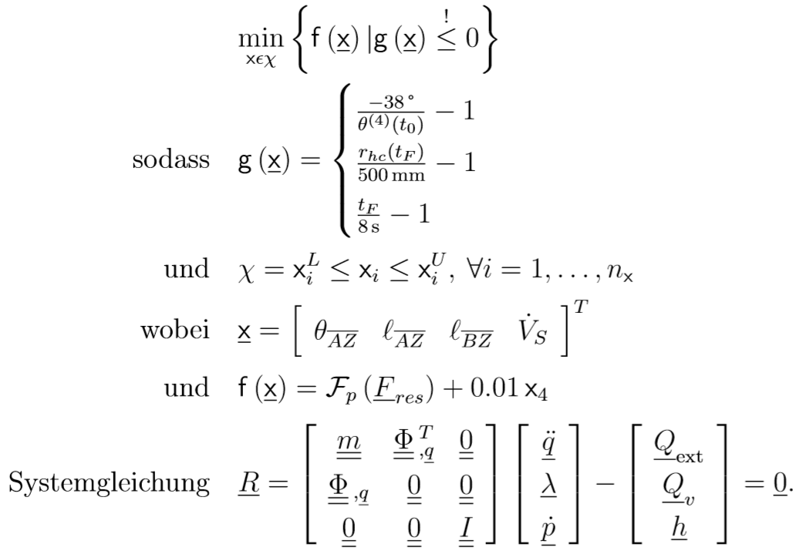
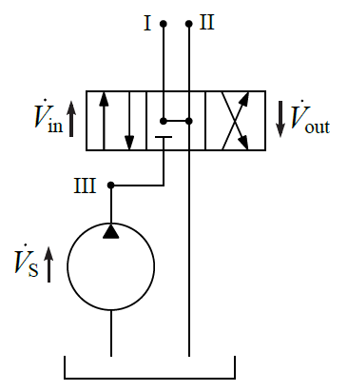

Optimization formulation
2nd order optimization algorithm: NLPQLP (Schittkowski, 2015)

Slide 5
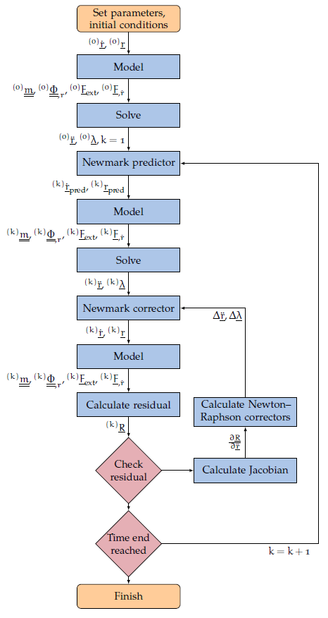
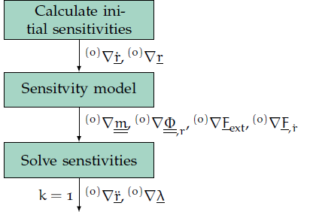
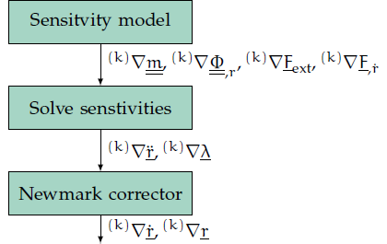
Newmark & Newton-Raphson with sensitivity analysis

Slide 6
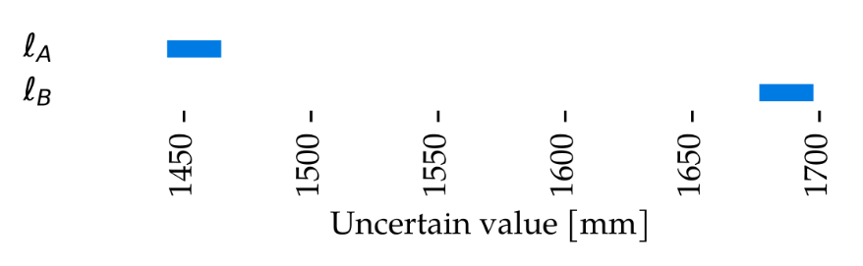
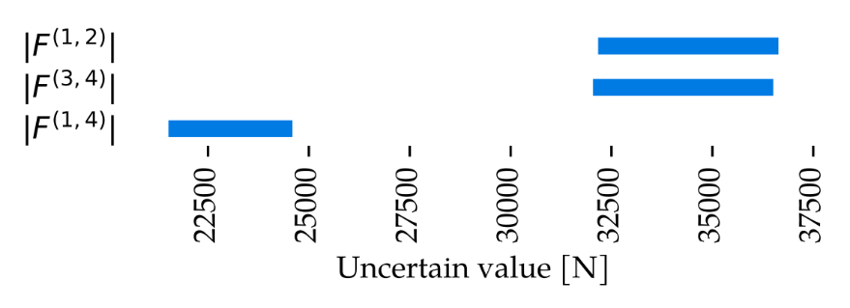
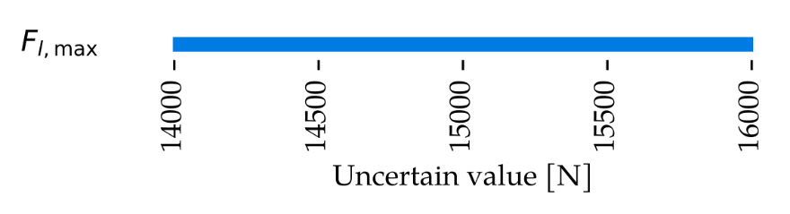
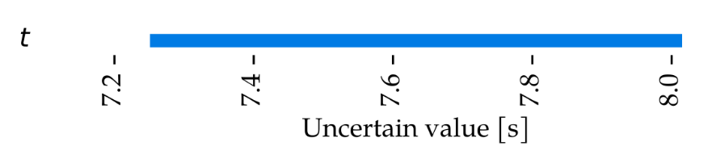
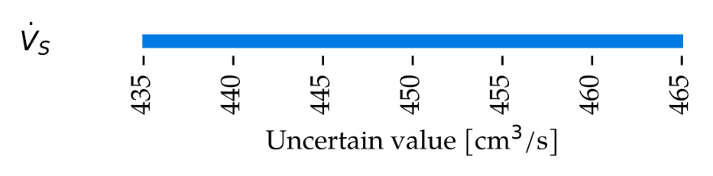
Uncertainty on Tyrolean weir cleaning mechanism
Uncertain parameters
Uncertain system responces
34387
23042
34259
7.62

Slide 7
Publications
IFToMM D-A-CH conference 2020 in Lienz
Presentation on February 28, 2020
IFIT 2020
Paper submitted on March 9, 2020
Review deadline: April 22, 2020

Slide 8
Optimization of rigid multibody systems in 2D
Optimization of flexible multibody systems in 3D

Slide 9
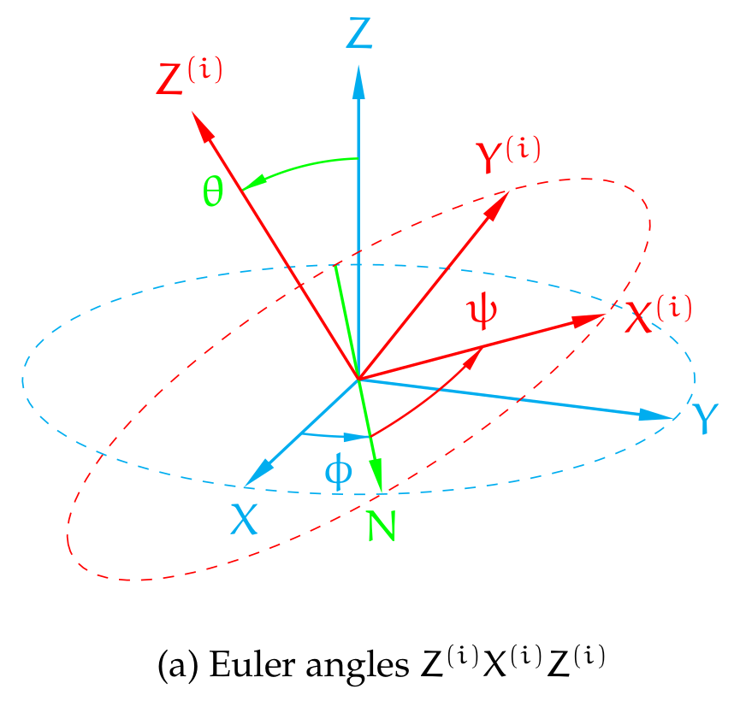
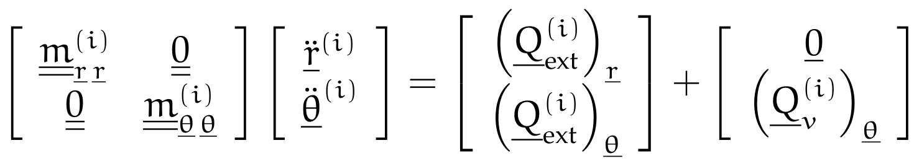
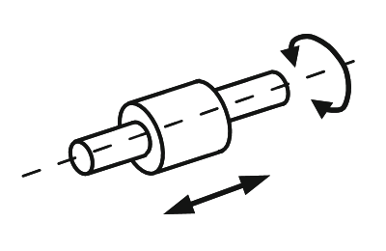
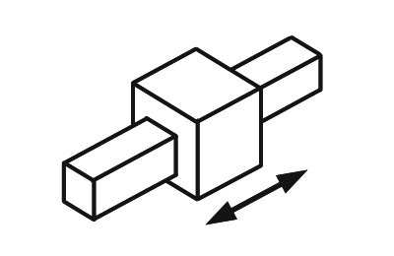
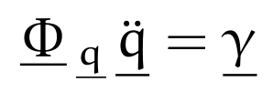
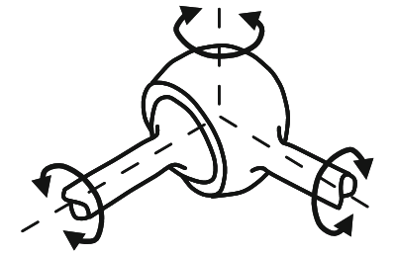
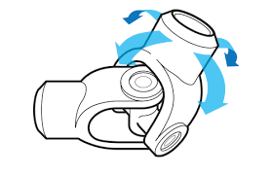
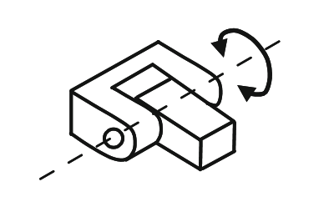
Rigid multibody dynamics: 2D => 3D
Spacial coordinates
Euler angles
More complex dynamics
Derivations of constraint equations in 3D
Cylindrical joint
Prismatic joint
Spherical joint
Revolute joint
Universal joint

Slide 10
Rigid multibody dynamics: 2D => 3D
Implementation of Tyrolean weir cleaning mechanism
Newmark & Newton-Raphson
Semi-analytic sensitivities
Higher computational effort; reduction possible?
Progress:
Asymmetric load
Joint forces
Model is ready for optimization
Implementation of simple examples
With faster computations

Slide 11
Implementation of simple examples
Simple pendulum
Slider crank mechanism
joint friction
driving moment
driving moment
friction
Simulations are running! Singularities.

Slide 12


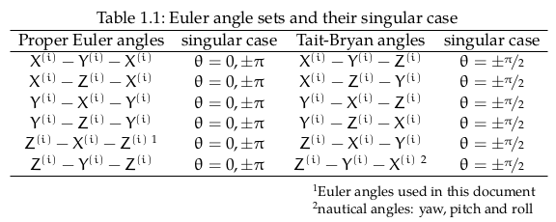

Singularities
Kinematic/geometric singularity
Euler angles:
when 1st and 3rd rotation axes have same or opposite direction
Euler parameters:
No kinematic singularities
Kinetic/dynamic singularity
Singular mass matrix
Euler angles & parameters
In Python
No solution with inv or solve
Solution with lstsq

Slide 13
Next steps
Review formulations – Literature survey (due mid-June)
Limited to scope of optimization: parametrization, sensitivity, computational effort
Position and orientation: coordinate formulations
Euler angles, Euler parameters, Rodriguez parameters, Denavit-Hartenberg
Flexible multibody dynamics
Absolute nodal coordinate, floating frame of reference, equivalent rigid-link system, …
Implementation & optimization
Journal articles
Optimization of rigid multibody dynamics in 3D (early summer)
Tyrolean weir & slider crank
Analytical sensitivity analysis
More complicated load case (asymmetry)
Applied paper on Tyrolean weir design (early autumn)

Slide 14
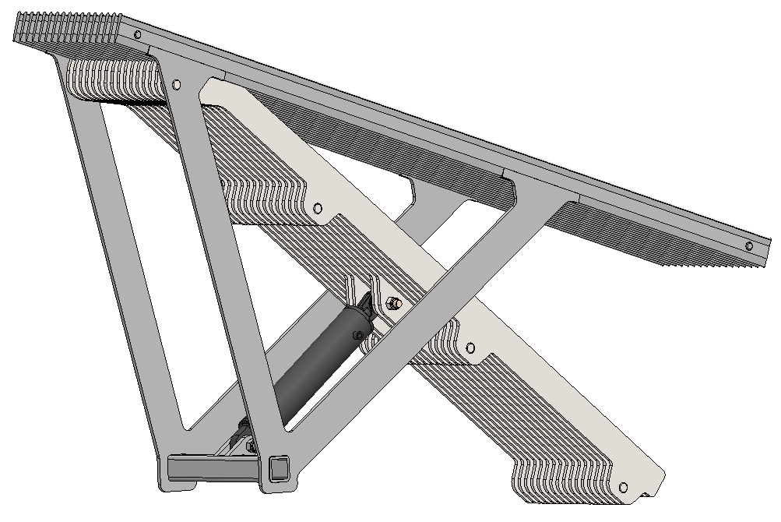
Thank you for your attention.
April 23, 2020
PhD in Advanced System Engineering
Status update
Student: Veit Gufler
Supervisors: Dr.-Ing. Erich Wehrle
Prof. Renato Vidoni

